Slide 1




Frontend Class - 6

Slide 2
NativeScript

Slide 3
NativeScript
Open source framework for building truly native mobile apps with
TypeScript, JavaScript, CSS
Angular
Vue.js

Slide 4
NativeScript
Open source framework for building truly native mobile apps with
TypeScript, JavaScript, CSS
Angular
Vue.js

Slide 5
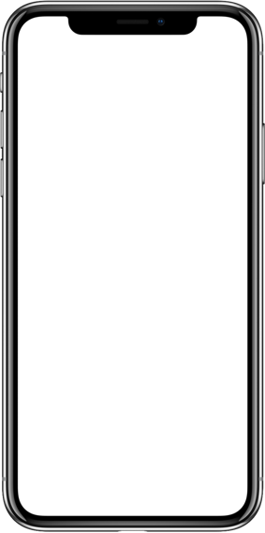

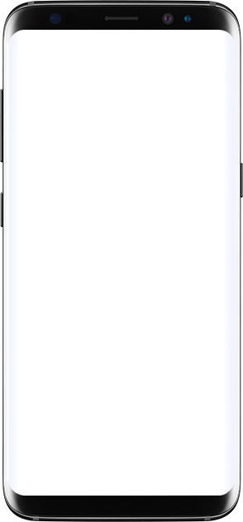




NativeScript
NativeScript
Build UI
NativeScript
iOS Runtime
<Button
(tap)="onTap($event)"
class="btn">
</Button>
Android Runtime
↓
↓
Write app logic
Call Native APIs
Style with CSS
Call Native APIs
↓
↓
.btn { background-color: #eeeeee; color: black; border-radius: 4; }
UIButton
android.widget.Button

Slide 6
NativeScript – UI Widgets

Slide 7
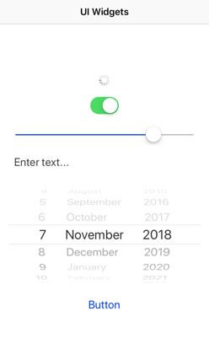
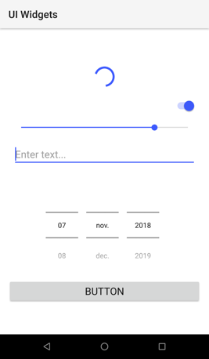

NativeScript – UI Widgets
<ActionBar title="UI Widgets"></ActionBar>
<ActivityIndicator busy="true"></ActivityIndicator>
<Switch checked="true"></Switch>
<Slider value="80"></Slider>
<TextField hint="Enter text..."></TextField>
<DatePicker minDate="2018-11-07"></DatePicker>
<Button text="Button"></Button>

Slide 8
NativeScript – UI widgets
Dialogs
FormattedString
Gestures
HtmlView
Image
Label
ListPicker
ListView
Placeholder
Progress
ScrollView
SearchBar
SegementedBar
TabView
TextView
TimePicker
WebView
https://docs.nativescript.org/angular/ui/components

Slide 9
NativeScript – Layout Containers

Slide 10
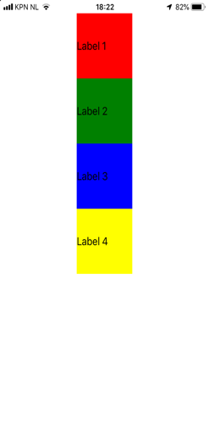
NativeScript – Layout Containers
StackLayout
<StackLayout>
<Label text="Label 1" backgroundColor="red" width="100" height="100"></Label>
<Label text="Label 2" backgroundColor="green" width="100" height="100"></Label>
<Label text="Label 3" backgroundColor="blue" width="100" height="100"></Label>
<Label text="Label 4" backgroundColor="yellow" width="100" height="100"></Label>
</StackLayout>

Slide 11
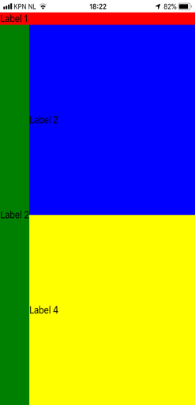
NativeScript – Layout Containers
GridLayout
<GridLayout columns="auto, *" rows="auto, *, *">
<Label text="Label 1" row="0" col="0" colSpan="2" backgroundColor="red"></Label>
<Label text="Label 2" row="1" col="0" rowSpan="2" backgroundColor="green"></Label>
<Label text="Label 2" row="1" col="1” backgroundColor="blue"></Label>
<Label text="Label 4" row="2" col="1” backgroundColor="yellow"></Label>
</GridLayout>

Slide 12
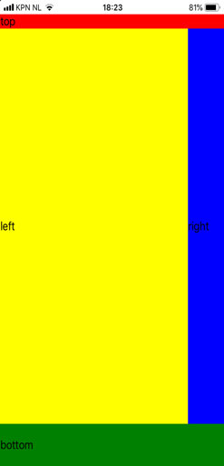
NativeScript – Layout Containers
DockLayout
<DockLayout>
<Label text="top" dock="top” backgroundColor="red"></Label>
<Label text="bottom" dock="bottom" height="60" backgroundColor="green"></Label>
<Label text="right" dock="right" width="60" backgroundColor="blue"></Label>
<Label text="left" dock="left" backgroundColor="yellow"></Label>
</DockLayout>

Slide 13
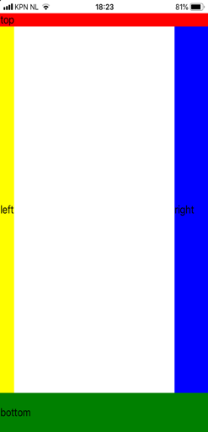
NativeScript – Layout Containers
DockLayout
<DockLayout stretchLastChild="false">
<Label text="top" dock="top” backgroundColor="red"></Label>
<Label text="bottom" dock="bottom" height="60" backgroundColor="green"></Label>
<Label text="right" dock="right" width="60" backgroundColor="blue"></Label>
<Label text="left" dock="left" backgroundColor="yellow"></Label>
</DockLayout>

Slide 14
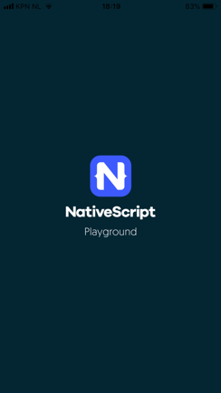
NativeScript – Layout Containers
More layout containers …
AbsoluteLayout
WrapLayout
FlexboxLayout
https://docs.nativescript.org/angular/ui/layouts/layout-containers

Slide 15
NativeScript Playground
Write NativeScript code in the browser and preview on your device in seconds
https://play.nativescript.org

Slide 16
NativeScript Playground
NativeScript
Playground
NativeScript
Preview
https://play.nativescript.org

Slide 17
NativeScript – Theming
Styles can be set on 3 different levels:
Application-wide CSS
Component-specific CSS
Inline CSS

Slide 18
NativeScript – Theming
NativeScript supports a subset of the CSS Selector syntax
Type selector
Class selector
ID selector
Hierarchical selector (CSS Combinators)
Attribute selector
Pseudo selector :highlighted
https://docs.nativescript.org/angular/ui/styling

Slide 19
NativeScript – Theming
Very much like CSS on web …
… except for Measurement units
NativeScript supports:
Device Independent Pixels (DIPs)
Pixels (postfix px)
Percentages

Slide 20
NativeScript – Theming
Platform specific styling:
Platform specific css files app.ios.css app.android.css
Inline styling ios:style="..." android:style = "..."
Markup blocks <ios> ... </ios> <android> ... </android>

Slide 21
NativeScript - Themes
NativeScript comes with 13 predefined color schemes

Slide 22
NativeScript – Native code
All native iOS and Android APIs can be accessed with JavaScript

Slide 23
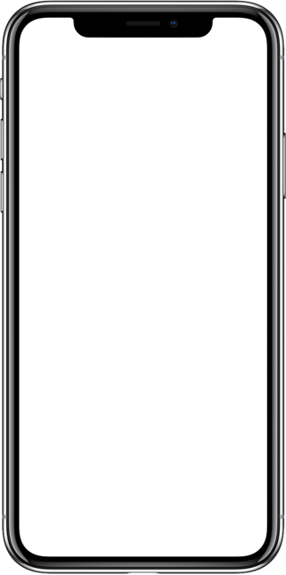
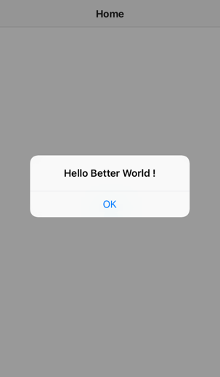
NativeScript – Native code
let alert = UIAlertView.new();
alert.message = 'Hello Better World !'; alert.addButtonWithTitle('OK’)
alert.show();

Slide 24
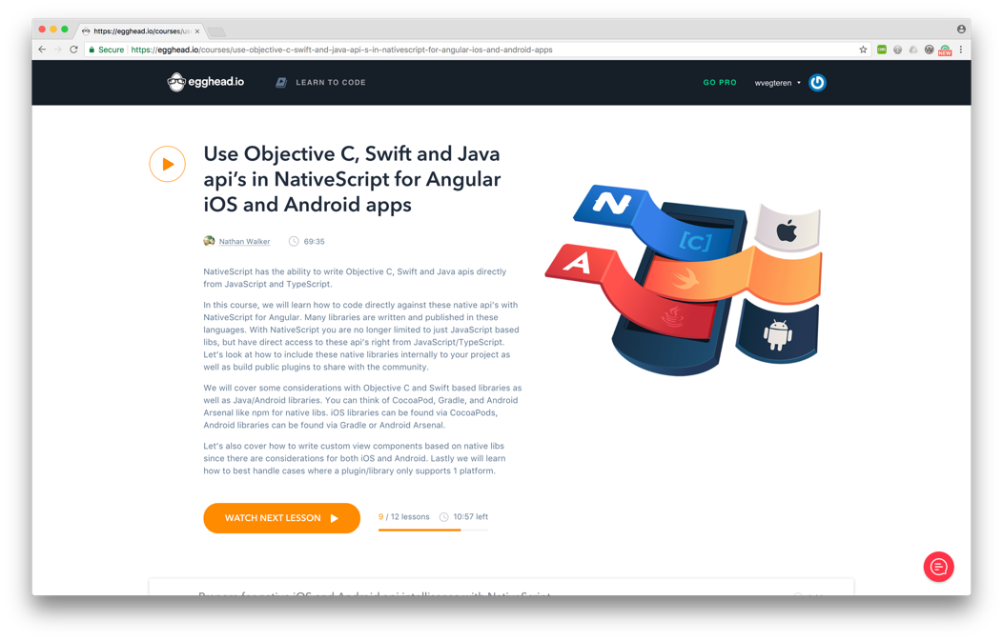
NativeScript – Native code
https://egghead.io/courses/use-objective-c-swift-and-java-api-s-in-nativescript-for-angular-ios-and-android-apps

Slide 25



NativeScript – Native code
import {File} from "tns-core-modules/file-system";
let file = new File();
NSFileManager.defaultManager()
new java.io.File( path );

Slide 26





NativeScript – Plugins
API

Slide 27
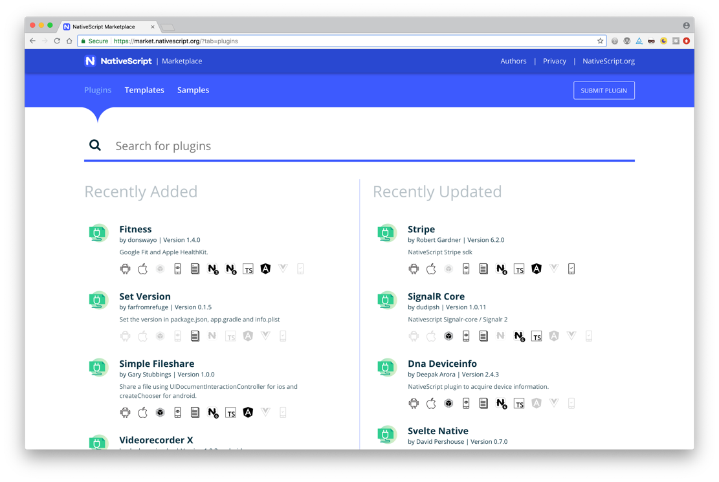
NativeScript – Plugins

Slide 28
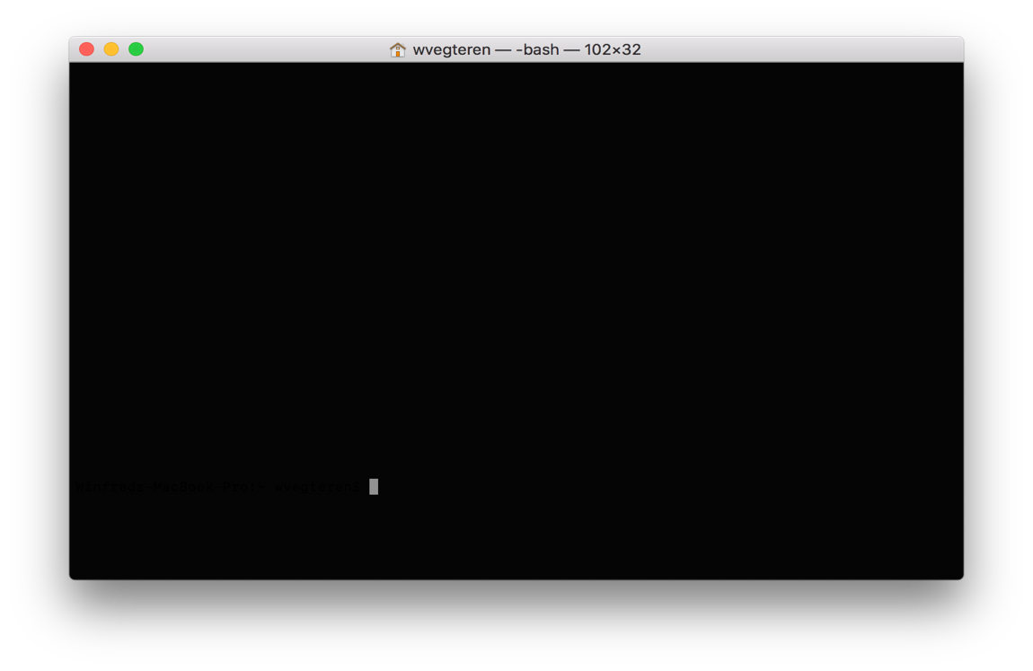
NativeScript – CLI
> npm install nativescript – g

Slide 29
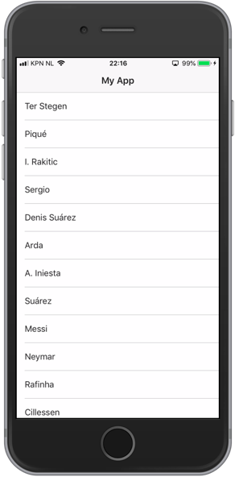
NativeScript – CLI
> tns create MyEpicApp --ng
> cd MyEpicApp
> tns run ios

Slide 30
NativeScript – CLI
> tns create MyEpicApp --ng
> cd MyEpicApp
> tns run ios
> tns run android

Slide 31
NativeScript – CLI
Many more commands …
debug
test
run
build
https://docs.nativescript.org/tooling/docs-cli

Slide 32
NativeScript – Sidekick
UI around NativeScript CLI … with some extras
Create – run – debug your app
Cloud builds
Icon / splashscreen generator
https://www.nativescript.org/nativescript-sidekick

Slide 33
NativeScript
https://www.nativescript.org

